Slide 1
INTERLINKING PSYCHOLOGICAL APPROACHES WITH SOCIAL STRATEGIES FOR HOLISTIC HEALTH
ZESULIWE MTHEMBU-MABASO
SOCIAL WORK MANAGER
DISTRICT SPECIALIST MENTAL HEALTH TEAM REGION 4
13 JANUARY 2025

Slide 2
INTRODUCTION
This session focuses specifically on how interlinking psychological approaches and social strategies enables holistic health outcomes, rather than viewing them as separate or parallel interventions.
In real-world health settings, psychological symptoms often emerge from social distress, while social challenges are intensified by psychological vulnerability. When these are addressed in isolation, care becomes fragmented and less effective.
The integration of preventative and curative care is only possible when psychological and social interventions are intentionally connected within multidisciplinary health practice.

Slide 3
INTRODUCTION
Purpose of the session
To demonstrate how psychological approaches and social strategies complement and strengthen one another.
To show how this integration supports both prevention and treatment across the continuum of care.
Learning objectives
By the end of this session, participants will be able to:
Explain how psychological and social interventions interlink to promote holistic health.
Identify missed opportunities when care is fragmented.
Apply integrated approaches within preventative and curative services.

Slide 4
UNDERSTANDING HOLISTIC HEALTH THROUGH INTEGRATION
Holistic health redefined
Holistic health is achieved not by adding multiple services, but by interlinking psychological and social responses to a person’s lived reality.
Psychological approaches contribute:
Insight into thoughts, emotions, behaviours, and trauma responses.
Skills for emotional regulation, coping, meaning-making, and behaviour change.
Social strategies contribute:
Addressing lived conditions such as poverty, violence, isolation, and family dynamics.
Mobilising resources, social protection, and community support systems.
The interlinking point
Psychological healing cannot be sustained without social stability, and social interventions are ineffective without psychological readiness and support.
Practical implication
Treating anxiety without addressing unemployment leads to relapse.
Providing food parcels without emotional support sustains dependency, not wellness.

Slide 5
Interlinking Prevention and Cure Through Psychology and Social Strategies
Prevention through integration
When psychological and social approaches are linked early:
Emotional distress is identified before it becomes pathology.
Social risks are addressed before crisis intervention is required.
Examples:
Psychoeducation + parenting support
School-based mental health screening + social services referral
Curative care strengthened by integration
In treatment settings:
Psychological therapy addresses internal processes.
Social interventions stabilise the external environment.
Examples:
Depression treatment + food security interventions
Trauma therapy + GBV shelter and legal support
Connection to the theme
Integrating preventative and curative care means responding to both why a person is unwell and what maintains the illness.

Slide 6
Psychological Approaches Relevant to Holistic Health
Key approaches
1. Cognitive Behavioural Approaches (CBT-informed)
Understanding thought–emotion–behaviour links.
Useful in depression, anxiety, adherence challenges.
2. Trauma-Informed Care
Recognises impact of trauma on behaviour and health.
Emphasises safety, choice, trust, collaboration, empowerment.
3. Person-Centred Approach
Respect for autonomy, dignity, lived experience.
Builds therapeutic alliance across disciplines.
4. Strengths-Based Perspective
Focuses on resilience and existing capacities.
Aligns well with community and social development work.

Slide 7
Social Strategies for Holistic Health
Core social strategies
1. Addressing Social Determinants of Health
Food security, housing, income, safety.
Intersectoral referrals (DSD, NGOs, education, labour).
2. Family and Community Systems Approach
Individual health is embedded in family and community context.
Engaging caregivers, partners, community leaders.
3. Social Support and Networks
Peer support groups.
Community-based mental health initiatives.
4. Advocacy and Policy Engagement
Identifying systemic barriers.
Using data and cases to influence service improvement.

Slide 8
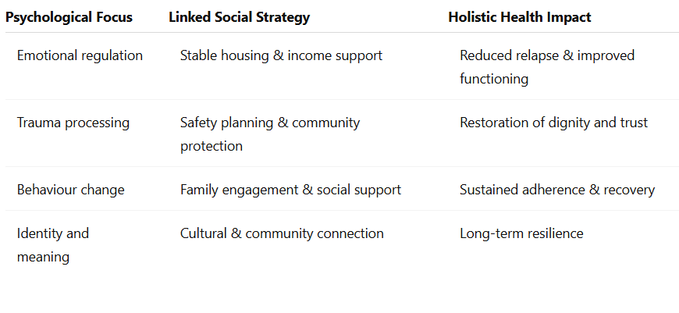
How Interlinking Psychological and Social Approaches Enables Holistic Health
Why interlinking matters
Fragmented care treats parts of a person. Integrated care restores the whole person.
Interlinking in practice

Slide 9
Brief integrated case example
A patient presenting with chronic anxiety and somatic complaints:
Psychological approach: trauma-informed counselling and coping skills.
Social strategy: addressing domestic instability and social isolation.
Outcome: reduced health service utilisation and improved quality of life.
Holistic health emerges at the point where psychological insight meets social action.

Slide 10
Role of the Multidisciplinary Team (MDT)
Why MDTs matter
No single discipline can address holistic health alone.
Complementary roles
Medical: diagnosis, treatment, monitoring.
Psychological: emotional regulation, insight, behaviour change.
Social work: social assessment, resource mobilisation, advocacy.
Nursing & CHWs: continuity of care, education, follow-up.
Principles of effective MDT work
Shared care plans.
Clear referral pathways.
Mutual respect for professional roles.

Slide 11
Practical Strategies for Integration in Multidisciplinary Health Practice
This section translates integration from theory into day-to-day practice, demonstrating how psychological approaches and social strategies can be operationalised across preventative and curative care.
Integration at Service Level
a) Holistic entry-point assessments
Incorporate routine psychosocial screening in all clinical services.
Assess emotional well-being and social determinants at first contact.
Use standardised tools combined with narrative assessment.
b) Integrated care planning
Develop care plans that include psychological goals and social interventions.
Align medical, psychological, and social objectives.
Review plans jointly in MDT meetings.
c) Joint case discussions and referrals
Regular MDT case reviews to prevent fragmented interventions.
Warm referrals rather than paper-based handovers.
Clear feedback loops between disciplines.

Slide 12
Conclusion: Linking Integration to the Theme
Reconnecting to the theme
Integrating preventative and curative care in multidisciplinary practice requires:
Seeing psychological and social care as interdependent, not optional add-ons.
Designing services that respond across the life course and care continuum.
Final key takeaways
Psychological approaches prepare individuals for healing and change.
Social strategies create environments where healing can be sustained.
Multidisciplinary teams are the bridge that connects prevention and cure.
Closing reflection
When psychology and social strategies work together, health systems move from managing illness to cultivating wholeness.

